Slide 2

Passive
Voice

Slide 3

ДЕЙСТВИТЕЛЬНЫЙ ЗАЛОГ
Он ест яблоко
He is eating an apple.
СТРАДАТЕЛЬНЫЙ ЗАЛОГ
Яблоко съедено им.
The apple is eaten by him.

Slide 4
Способ образования страдательного залога
to be + V3/ved
(изменяемая часть) (неизменяемая часть)
am
is _{+ written/cooked}
are

Slide 5
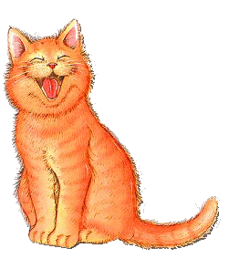
Today is a very interesting day. I look at the window and see the Sun shining. The boy is played by the ball.
The uncle Tom is cooked by ham. The aunt Jenny is cleaned by the room. Katya is washed by the cat.
Help me to make this story true!

Slide 6

Today is a very interesting day. I look at the window and see the Sun shining. The ball is played by the boy.
Ham is cooked by the uncle Tom. The room is cleaned by the aunt Jenny. The cat is washed by Katya.

Slide 7

By somebody – кем-то
Translate into English:
Папой
Димой
Куклой
Птицами
Учениками
Нами
Катей

Slide 8
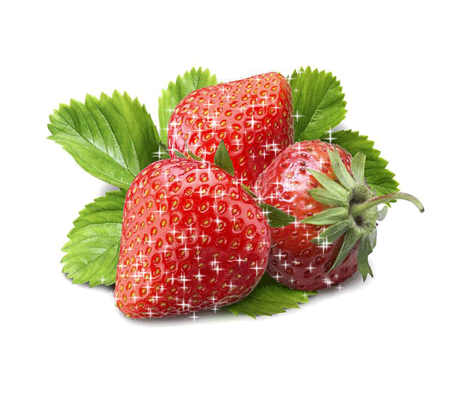
Переведите на русский язык
Lunch is cooked.
The room is cleaned.
Fruits are bought.
Films are watched.
She is known.
They are called.

Slide 9
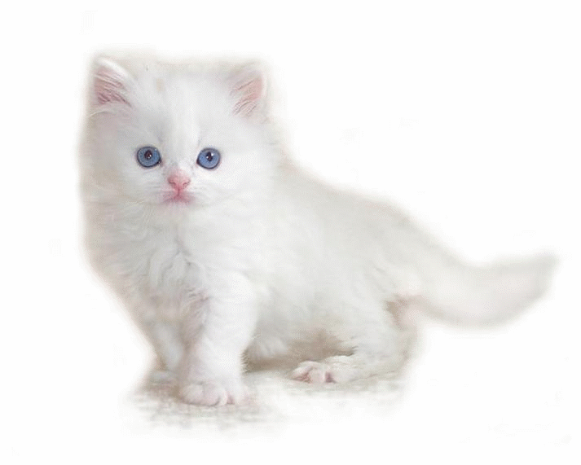
Translate into English
Домашнюю работу выполняют (делают).
Кота ловит Джилл.
Торт готовится мамой.
Новую газету дают дедушке.
Кофе выпивается Томом.

Slide 10

Homework is done.
The cat is caught by Jill.
The cake is cooked by the mother.
The new newspaper is given to the grandfather.
Coffee is drunk by Tom.

Slide 11
Home work.
Ex.7 p.107 письменно

