Slide 1
The 13th of may.
Class work.

Slide 2
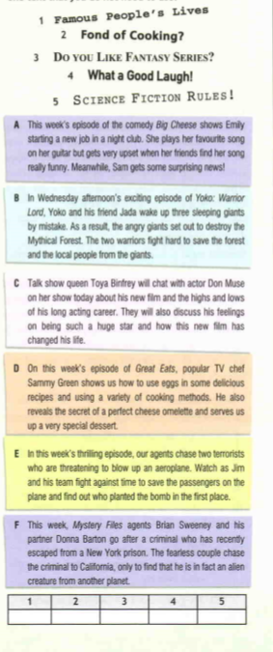
Match the headings to the text:
Reading p. 136

Slide 3
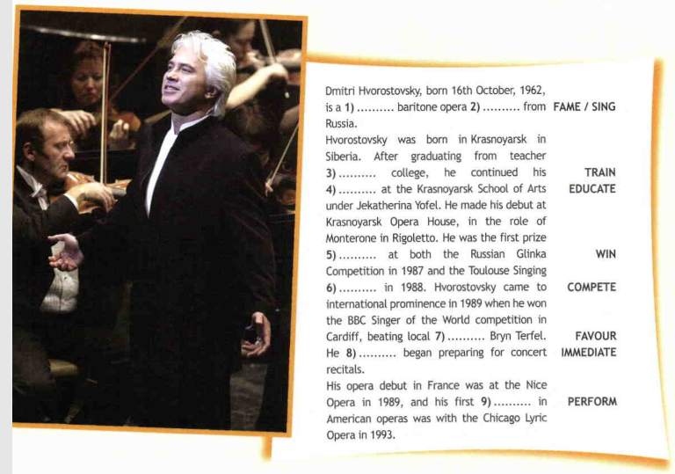
Change the words and put them to the sentences:

Slide 4
Home work.
Writing p.137 (write the letter, using 100-140 words)

